Slide 1
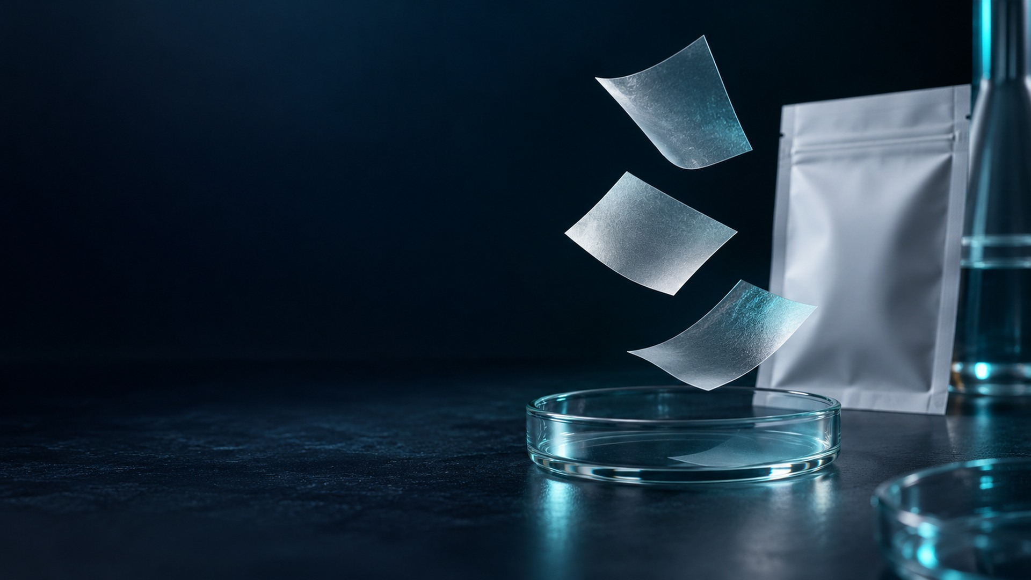

DISSOLVABLE ORAL FILM
DISSOLVABLE ORAL FILM
01
OEM / ODM / PRIVATE LABEL
OEM / ODM / PRIVATE LABEL
Custom Oral Film
Product Brochure
A source-grounded portfolio of formulation
directions, project gates, quality boundaries
and flavor options.
2026 • ENGLISH EDITION
www.dissolvableoralfilm.com
dissolvableoralfilm.com
Notes:
Source: C:\Users\Administrator\Documents\LOCAL HOST\hytan_oral_brochure_20261008\output\HYTAN_BIO_TECH_Oral_Film_Brochure_EN_Final_20261008.pdf | source pages 1. Website/PPT adaptation: generated imagery matches the site palette and is representative, not documentary evidence of audited facilities or finished commercial products. Product concepts require formula feasibility, stability, documentation and destination-market review.

Slide 2
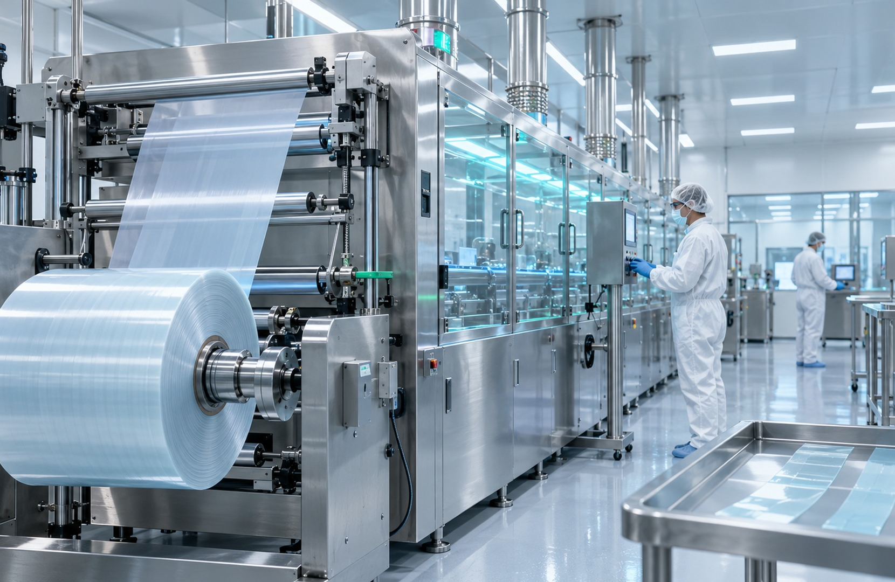
DISSOLVABLE ORAL FILM
02
SOURCE-GROUNDED CAPABILITY
Manufacturing & development overview
2M
600M+
200+
films/day source
annual source reference
R&D and production staff
reference
4,000 m²+ R&D center
The brochure describes formulation development, testing and scale-up
support.
Class 100,000 clean area
Facility classifications, output and staffing should be confirmed for the
contracted site and scope.
Brochure figures are presented as company-supplied references, not independently audited claims.
dissolvableoralfilm.com
Notes:
Source: C:\Users\Administrator\Documents\LOCAL HOST\hytan_oral_brochure_20261008\output\HYTAN_BIO_TECH_Oral_Film_Brochure_EN_Final_20261008.pdf | source pages 3. Website/PPT adaptation: generated imagery matches the site palette and is representative, not documentary evidence of audited facilities or finished commercial products. Product concepts require formula feasibility, stability, documentation and destination-market review.

Slide 3
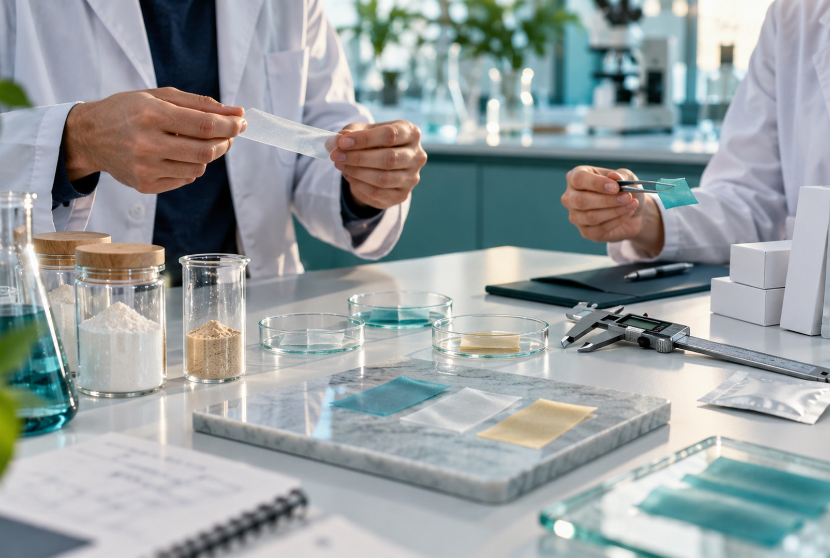
DISSOLVABLE ORAL FILM
03
OEM / ODM WORKFLOW
Custom development built around feasibility
Formula design
Ingredient identity, intended use, practical loading and sensory
constraints are screened together.
Packaging integration
Moisture barrier, unit presentation, artwork and destination-market
labeling are aligned early.
Flavor & format
Flavor families, dimensions, texture and disintegration targets are
reviewed through samples.
Scheduling
The source mentions a standard-order target of 20 days; actual timing
is confirmed per project.
dissolvableoralfilm.com
Notes:
Source: C:\Users\Administrator\Documents\LOCAL HOST\hytan_oral_brochure_20261008\output\HYTAN_BIO_TECH_Oral_Film_Brochure_EN_Final_20261008.pdf | source pages 4. Website/PPT adaptation: generated imagery matches the site palette and is representative, not documentary evidence of audited facilities or finished commercial products. Product concepts require formula feasibility, stability, documentation and destination-market review.

Slide 4
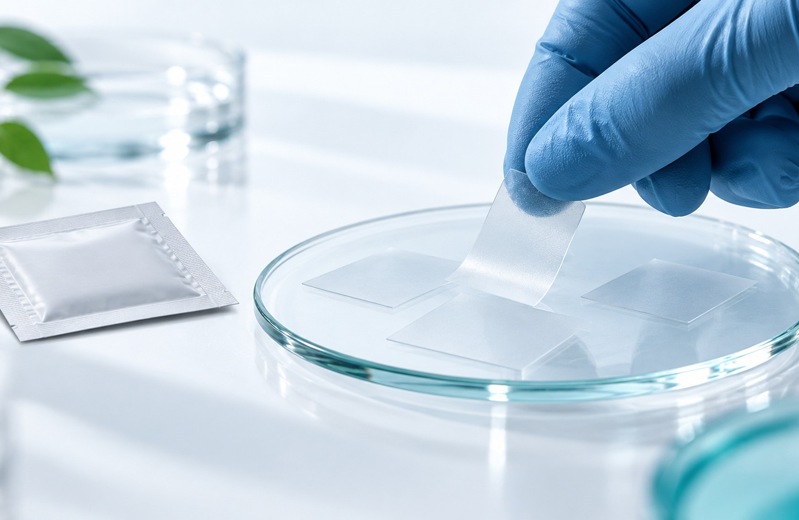
DISSOLVABLE ORAL FILM
04
FORMAT ATTRIBUTES
What the oral-film format can offer
Portable unit format
A thin, individually packed presentation can support convenient, water-free
use.
Experience engineering
Film size, texture, flavor, handling and disintegration are evaluated as one
system.
Protection by pack
Single-dose sachets can support moisture control and portability.
Dissolution alone does not establish absorption, bioavailability, onset time or clinical advantage. Claims require product-specific
evidence and market review.
dissolvableoralfilm.com
Notes:
Source: C:\Users\Administrator\Documents\LOCAL HOST\hytan_oral_brochure_20261008\output\HYTAN_BIO_TECH_Oral_Film_Brochure_EN_Final_20261008.pdf | source pages 5. Website/PPT adaptation: generated imagery matches the site palette and is representative, not documentary evidence of audited facilities or finished commercial products. Product concepts require formula feasibility, stability, documentation and destination-market review.

Slide 5

DISSOLVABLE ORAL FILM
05
QUALITY & DOCUMENTATION
Quality references need scope verification
GMP / HACCP
Confirm named legal entity, site, issuer, scope
and validity.
ISO 9001 / 22000
Confirm the audited management-system
scope and current certificate.
Halal / Kosher
Confirm ingredient, process, product and
facility coverage.
Project documents
Agree specifications, test reports, traceability
and change control.
Certification references in the brochure are not treated as blanket approval or endorsement for every product or market.
dissolvableoralfilm.com
Notes:
Source: C:\Users\Administrator\Documents\LOCAL HOST\hytan_oral_brochure_20261008\output\HYTAN_BIO_TECH_Oral_Film_Brochure_EN_Final_20261008.pdf | source pages 6. Website/PPT adaptation: generated imagery matches the site palette and is representative, not documentary evidence of audited facilities or finished commercial products. Product concepts require formula feasibility, stability, documentation and destination-market review.

Slide 6
DISSOLVABLE ORAL FILM
06
CUSTOM SERVICE PROCESS
Nine project gates from brief to support
01
Requirements discussion
02
Formula approval
03
Sample approval
04
Order confirmation
05
Deposit payment
06
Manufacturing
07
Balance settlement
08
Packing & dispatch
09
After-sales support
Prototype, artwork and final specifications are approved before manufacturing. Commercial and payment milestones follow the signed agreement.
dissolvableoralfilm.com
Notes:
Source: C:\Users\Administrator\Documents\LOCAL HOST\hytan_oral_brochure_20261008\output\HYTAN_BIO_TECH_Oral_Film_Brochure_EN_Final_20261008.pdf | source pages 7. Website/PPT adaptation: generated imagery matches the site palette and is representative, not documentary evidence of audited facilities or finished commercial products. Product concepts require formula feasibility, stability, documentation and destination-market review.

Slide 7
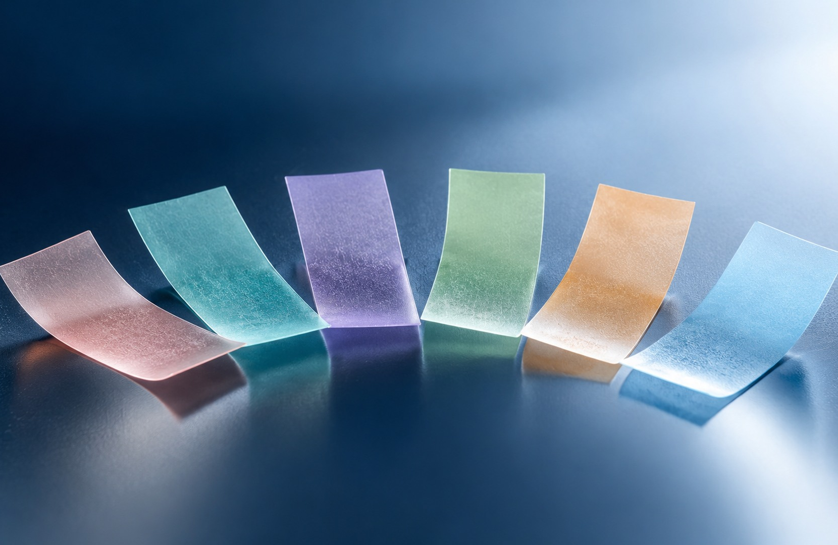
DISSOLVABLE ORAL FILM
07
PORTFOLIO MAP
Six product families, 48 brochure directions
A
Beauty & women
8
B
Essential nutrition
8
C
Brain health & sleep
8
D
Immunity & long-term health
12
E
Children & special groups
8
F
Sports health
8
These are customizable concept directions. Final ingredients, loading, dosage form performance, claims and legal classification remain project-
and market-specific.
dissolvableoralfilm.com
Notes:
Source: C:\Users\Administrator\Documents\LOCAL HOST\hytan_oral_brochure_20261008\output\HYTAN_BIO_TECH_Oral_Film_Brochure_EN_Final_20261008.pdf | source pages 8-27. Website/PPT adaptation: generated imagery matches the site palette and is representative, not documentary evidence of audited facilities or finished commercial products. Product concepts require formula feasibility, stability, documentation and destination-market review.

Slide 8

DISSOLVABLE ORAL FILM
08
PRODUCT CONCEPTS
Beauty & women’s wellness
Skin beauty, healthy-aging and women’s wellness concept directions.
A1
Collagen Firming
A5
CoQ10 Energy
A2
Hyaluronic Hydration
A6
Ergothioneine Antioxidant
A3
Antioxidant Brightening
A7
Menstrual Comfort
A4
Anti-Glycation Healthy Aging
A8
Menopause Support
No efficacy, approval, dosage or commercial availability is implied. Feasibility and evidence are confirmed for the selected formula and market.
dissolvableoralfilm.com
Notes:
Source: C:\Users\Administrator\Documents\LOCAL HOST\hytan_oral_brochure_20261008\output\HYTAN_BIO_TECH_Oral_Film_Brochure_EN_Final_20261008.pdf | source pages 9-11. Website/PPT adaptation: generated imagery matches the site palette and is representative, not documentary evidence of audited facilities or finished commercial products. Product concepts require formula feasibility, stability, documentation and destination-market review.

Slide 9
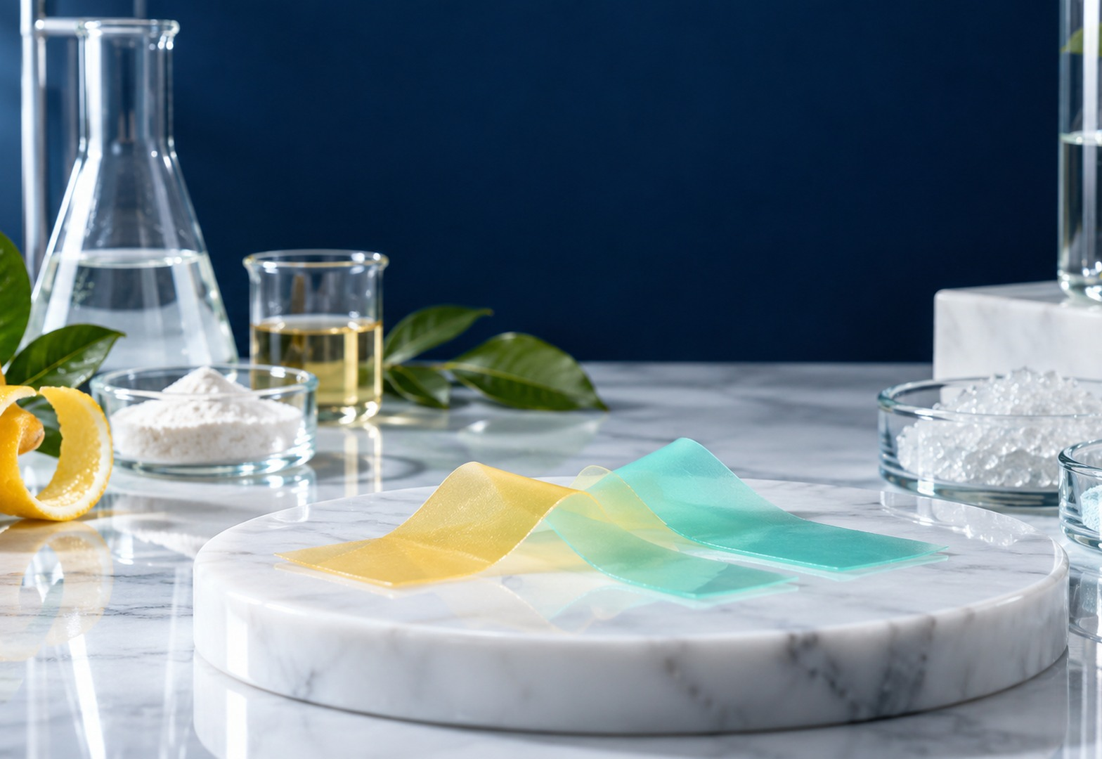
DISSOLVABLE ORAL FILM
09
PRODUCT CONCEPTS
Essential nutrition
Vitamin, mineral and essential-nutrient concepts for defined markets and
users.
B1
Vitamin C Immune
B5
Vitamin B12 Neuro Support
B2
Vitamin C + Zinc Immune
B6
B-Complex
B3
Vitamin D Calcium Support
B7
DHA Nutrition
B4
Vitamin D3 + K2 Bone
B8
Biotin Beauty
No efficacy, approval, dosage or commercial availability is implied. Feasibility and evidence are confirmed for the selected formula and market.
dissolvableoralfilm.com
Notes:
Source: C:\Users\Administrator\Documents\LOCAL HOST\hytan_oral_brochure_20261008\output\HYTAN_BIO_TECH_Oral_Film_Brochure_EN_Final_20261008.pdf | source pages 12-14. Website/PPT adaptation: generated imagery matches the site palette and is representative, not documentary evidence of audited facilities or finished commercial products. Product concepts require formula feasibility, stability, documentation and destination-market review.

Slide 10

DISSOLVABLE ORAL FILM
10
PRODUCT CONCEPTS
Brain health & sleep
Sleep, relaxation, focus and alertness concept directions.
C1
Melatonin Sleep
C5
Magnesium Relaxation
C2
Melatonin + Magnesium
C6
DHA Memory
C3
L-Theanine Calm
C7
B-Complex Vitality
C4
Focus
C8
Caffeine Energy
No efficacy, approval, dosage or commercial availability is implied. Feasibility and evidence are confirmed for the selected formula and market.
dissolvableoralfilm.com
Notes:
Source: C:\Users\Administrator\Documents\LOCAL HOST\hytan_oral_brochure_20261008\output\HYTAN_BIO_TECH_Oral_Film_Brochure_EN_Final_20261008.pdf | source pages 15-17. Website/PPT adaptation: generated imagery matches the site palette and is representative, not documentary evidence of audited facilities or finished commercial products. Product concepts require formula feasibility, stability, documentation and destination-market review.

Slide 11

DISSOLVABLE ORAL FILM
11
PRODUCT CONCEPTS
Immunity & long-term health
Ingredient-led immune, cardiovascular, antioxidant and metabolic
wellness directions.
D1
Vitamin C + Zinc Immune
D7
Allicin Lipid Support
D2
Beta-Glucan Immune
D8
Milk Thistle Liver Support
D3
Curcumin Wellness
D9
Red Ginseng
D4
CoQ10 Heart
D10
American Ginseng
D5
Omega-3 Cardiovascular
D11
Ginseng
D6
Magnesium Circulatory Support
D12
Post-Drink Liver Support
No efficacy, approval, dosage or commercial availability is implied. Feasibility and evidence are confirmed for the selected formula and market.
dissolvableoralfilm.com
Notes:
Source: C:\Users\Administrator\Documents\LOCAL HOST\hytan_oral_brochure_20261008\output\HYTAN_BIO_TECH_Oral_Film_Brochure_EN_Final_20261008.pdf | source pages 18-21. Website/PPT adaptation: generated imagery matches the site palette and is representative, not documentary evidence of audited facilities or finished commercial products. Product concepts require formula feasibility, stability, documentation and destination-market review.

Slide 12
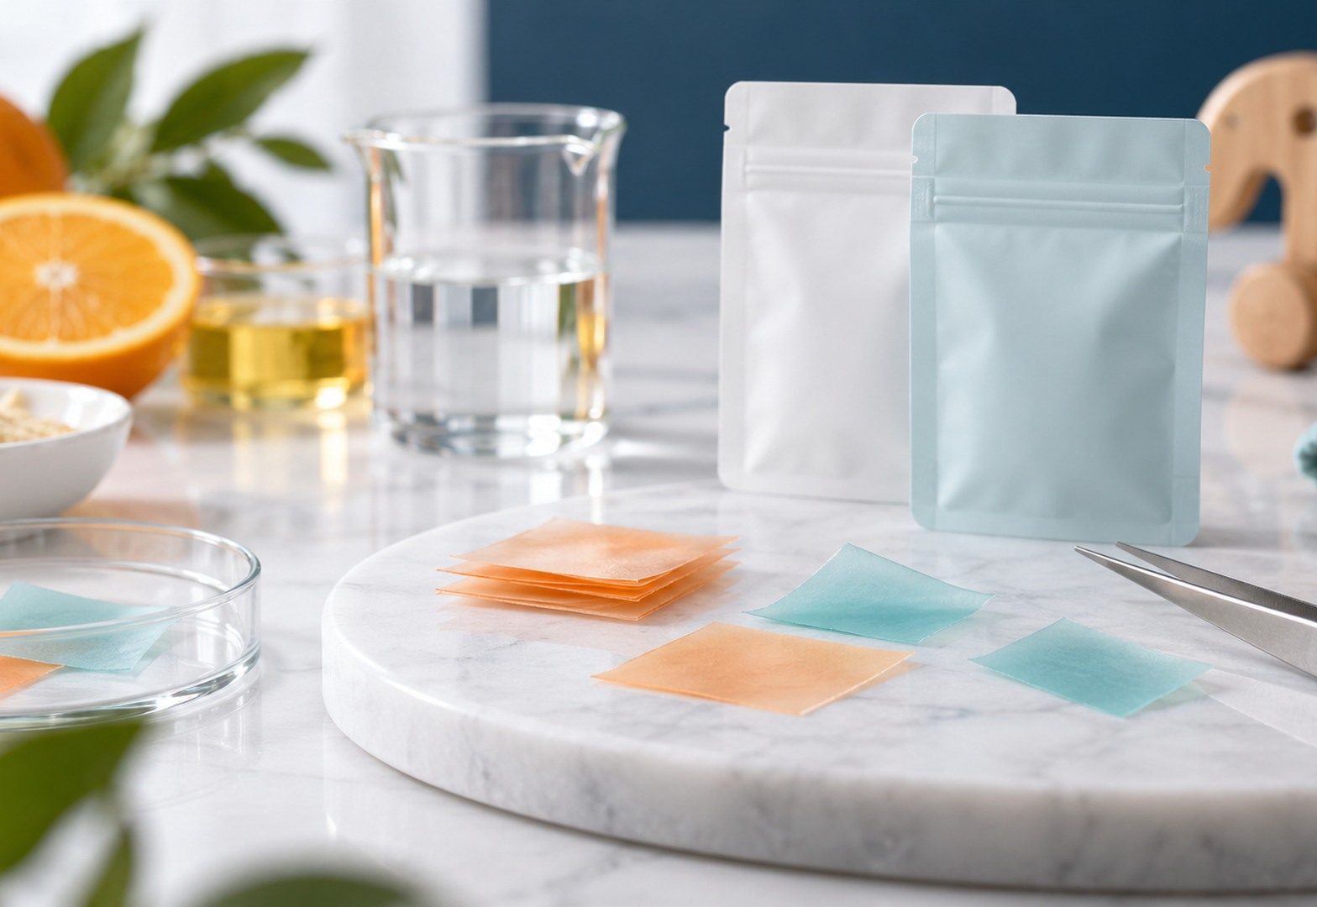
DISSOLVABLE ORAL FILM
12
PRODUCT CONCEPTS
Children & special populations
Age-specific concepts requiring suitability, documentation and qualified
review.
E1
Kids Vitamin D + Calcium
E5
Kids Multivitamin
E2
Kids DHA
E6
Prenatal Folate
E3
Kids Vitamin C Immune
E7
Prenatal Iron
E4
Kids Zinc Growth
E8
Senior Multivitamin
No efficacy, approval, dosage or commercial availability is implied. Feasibility and evidence are confirmed for the selected formula and market.
dissolvableoralfilm.com
Notes:
Source: C:\Users\Administrator\Documents\LOCAL HOST\hytan_oral_brochure_20261008\output\HYTAN_BIO_TECH_Oral_Film_Brochure_EN_Final_20261008.pdf | source pages 22-24. Website/PPT adaptation: generated imagery matches the site palette and is representative, not documentary evidence of audited facilities or finished commercial products. Product concepts require formula feasibility, stability, documentation and destination-market review.

Slide 13

DISSOLVABLE ORAL FILM
13
PRODUCT CONCEPTS
Sports & active nutrition
Energy, focus, electrolyte and recovery directions with practical loading
review.
F1
Caffeine Sports
F5
EAA Recovery
F2
Caffeine + L-Theanine
F6
Magnesium Muscle Support
F3
Electrolyte Hydration
F7
L-Carnitine Metabolism
F4
Creatine Strength
F8
BCAA Recovery
No efficacy, approval, dosage or commercial availability is implied. Feasibility and evidence are confirmed for the selected formula and market.
dissolvableoralfilm.com
Notes:
Source: C:\Users\Administrator\Documents\LOCAL HOST\hytan_oral_brochure_20261008\output\HYTAN_BIO_TECH_Oral_Film_Brochure_EN_Final_20261008.pdf | source pages 25-27. Website/PPT adaptation: generated imagery matches the site palette and is representative, not documentary evidence of audited facilities or finished commercial products. Product concepts require formula feasibility, stability, documentation and destination-market review.

Slide 14
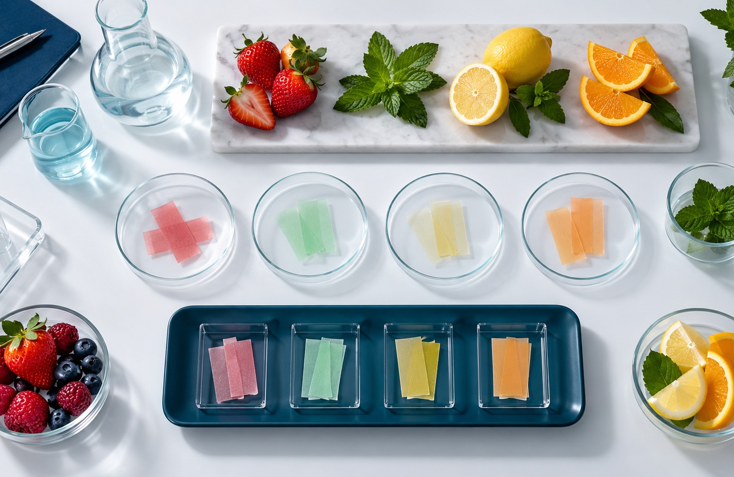
DISSOLVABLE ORAL FILM
14
SENSORY DEVELOPMENT
Flavor customization as a project variable
20
20
40
blended directions
mint directions
fruit directions
Build a sensory brief
Define audience, target profile, sweetness, cooling, aftertaste and pack
interaction.
Screen for compatibility
Flavor systems are evaluated with the active ingredients, film matrix and
stability plan.
The printed lists contain repeated flavor names. Availability, composition and labeling are confirmed by project; flavor names do not prove fruit
content.
dissolvableoralfilm.com
Notes:
Source: C:\Users\Administrator\Documents\LOCAL HOST\hytan_oral_brochure_20261008\output\HYTAN_BIO_TECH_Oral_Film_Brochure_EN_Final_20261008.pdf | source pages 28-29. Website/PPT adaptation: generated imagery matches the site palette and is representative, not documentary evidence of audited facilities or finished commercial products. Product concepts require formula feasibility, stability, documentation and destination-market review.

Slide 15
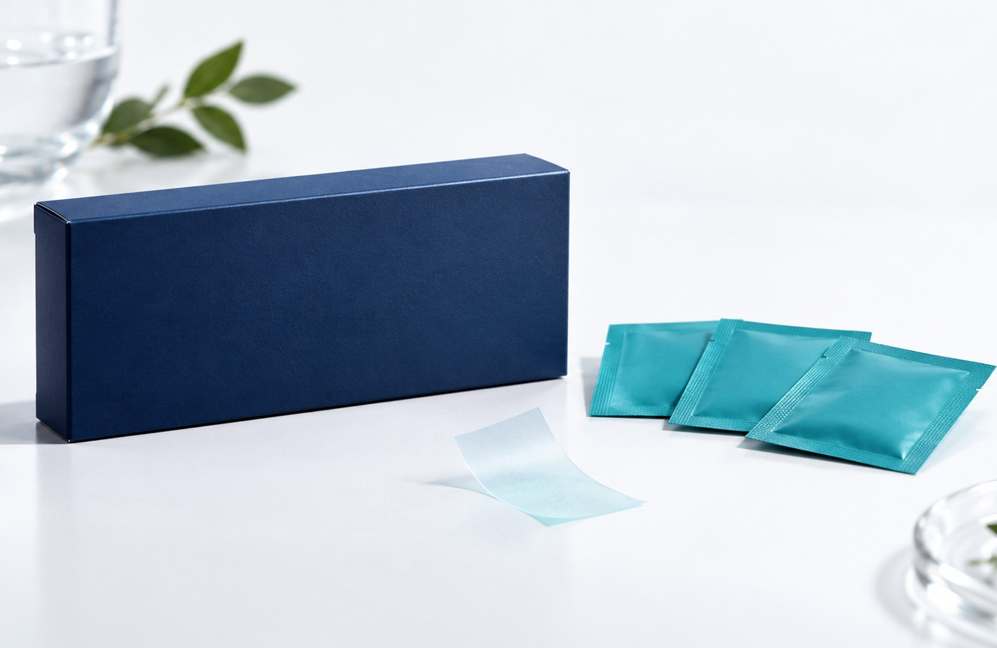
DISSOLVABLE ORAL FILM
15
PROJECT CONTACT
Start with your market and formulation brief
Share the target market, ingredient concept, sample
objective, packaging direction and documentation
needs.
EMAIL
info@hytanbio.com
WHATSAPP
+852 6240 8962
WEBSITE
dissolvableoralfilm.com
REQUEST A PROJECT QUOTE
dissolvableoralfilm.com
Notes:
Source: C:\Users\Administrator\Documents\LOCAL HOST\hytan_oral_brochure_20261008\output\HYTAN_BIO_TECH_Oral_Film_Brochure_EN_Final_20261008.pdf | source pages 30. Website/PPT adaptation: generated imagery matches the site palette and is representative, not documentary evidence of audited facilities or finished commercial products. Product concepts require formula feasibility, stability, documentation and destination-market review.

